Slide 1
Comp 313
Design and Analysis of Algorithms
Lecture 6 TREES AND ALGORITHMS

Slide 2
Lecture Outline
Introduction
What is a tree
Application areas
Reading materials

Slide 3
Trees & Algorithms
A Tree is a recursive data structure containing the set of one or more data nodes where one node is designated as the root of the tree while the remaining nodes are called as the children of the root.
.

Slide 4
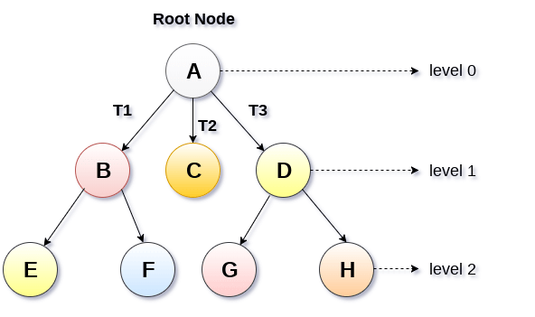

Slide 5
Applications
Storing hierarchical data like file structure, organization structure, XML/HTML data.
Search, insert, delete on a sorted data e.g Binary tree.
Indexing in databases e.g B tree
Used in Compilers e.g syntax tree.
Computer network , routing using spanning trees.
Data Compression e.g Huffman tree.

Slide 6
Huffman tree
Huffman coding tree or Huffman tree is a full binary tree in which each leaf of the tree corresponds to a letter in the given alphabet. Define the weighted path length of a leaf to be its weight times its depth.
Huffman Coding or Huffman Encoding is a Greedy Algorithm that is used for the lossless compression of data
Huffman Coding is a famous Greedy Algorithm.
It is used for the lossless compression of data.
It uses variable length encoding.
It assigns variable length code to all the characters.
The code length of a character depends on how frequently it occurs in the given text.
The character which occurs most frequently gets the smallest code.
The character which occurs least frequently gets the largest code.
It is also known as Huffman Encoding.

Slide 7
Steps in Huffman Coding
There are two major steps in Huffman Coding-
Building a Huffman Tree from the input characters.
Assigning code to the characters by traversing the Huffman Tree.
Huffman Tree-
The steps involved in the construction of Huffman Tree are as follows-
Step-01:
Create a leaf node for each character of the text.
Leaf node of a character contains the occurring frequency of that character.

Slide 8
Step-02:
Arrange all the nodes in increasing order of their frequency value.
Step-03:
Considering the first two nodes having minimum frequency,
Create a new internal node.
The frequency of this new node is the sum of frequency of those two nodes.
Make the first node as a left child and the other node as a right child of the newly created node.
Step-04:
Keep repeating Step-02 and Step-03 until all the nodes form a single tree.
The tree finally obtained is the desired Huffman Tree.

Slide 9
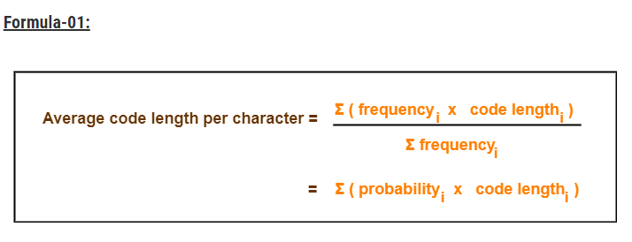
Important Formulas
The following 2 formulas are important to solve the problems based on Huffman Coding-

Slide 10
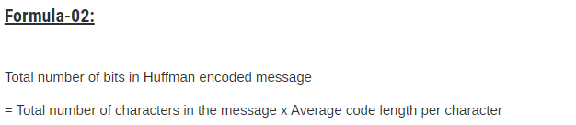


Slide 11
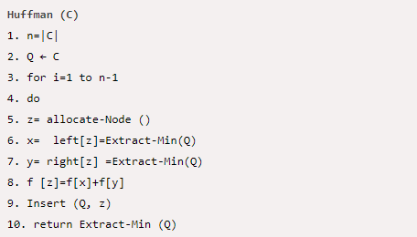
Huffman Algorithm (greedy)

Slide 12

Example
Find an optimal Huffman Code for the following set of characters and frequencies:

Slide 13
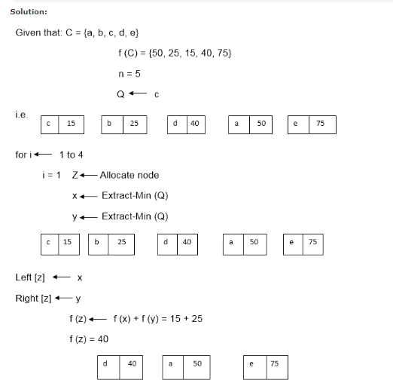

Slide 14
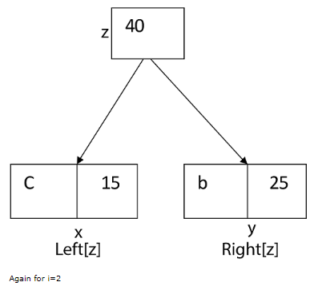

Slide 15
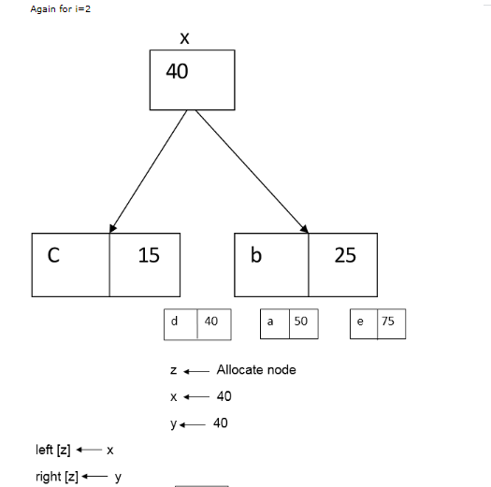

Slide 16
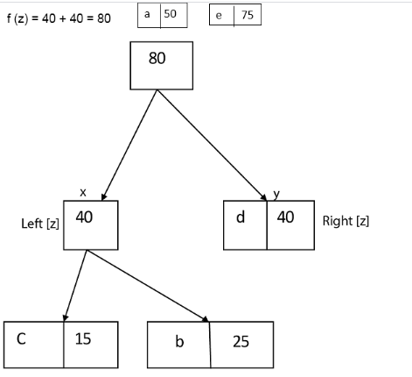

Slide 17
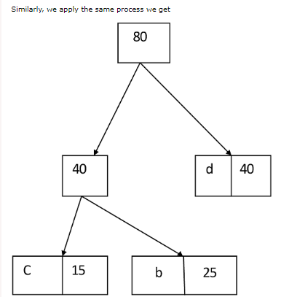

Slide 18
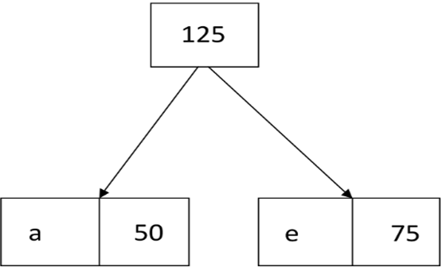

Slide 19
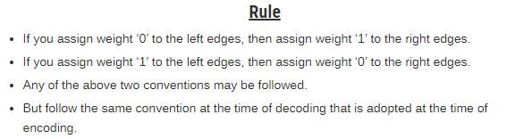
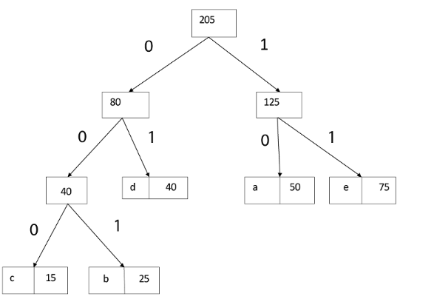
Final output
d=01
a=10
e=11
c=000
b=001

Slide 20
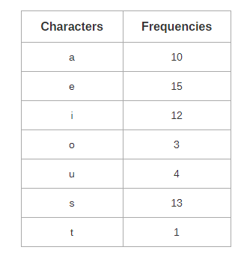
Exercise

Slide 21
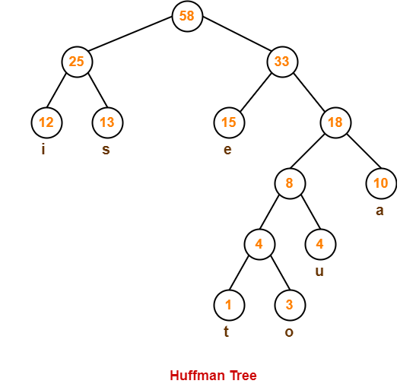

Slide 22
Tree Search Algorithms
BFS(BREADTH FIRST SEARCH)
DFS(DEPTH FIRST SEARCH)
Criteria of evaluating a search
Completeness
Optimality
Space complexity
Time complexity

Slide 23
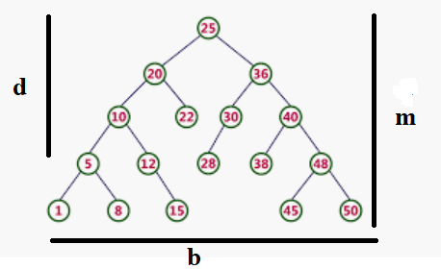
Space complexity & Time complexity
Space and time complexity is measured in terms of
b- breadth of the tree/branching factor
d- depth of the least cost solution.
m- maximum depth space
M MAY BE INFINITY

Slide 24
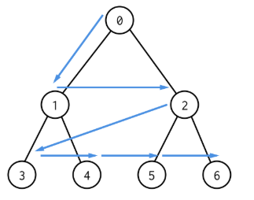
Breadth First search
BFS is a traversing algorithm where you should start traversing from a selected node (source or starting node) and traverse the graph layerwise thus exploring the neighbour nodes (nodes which are directly connected to source node). You must then move towards the next-level neighbour nodes.
Level by Level.

Slide 25
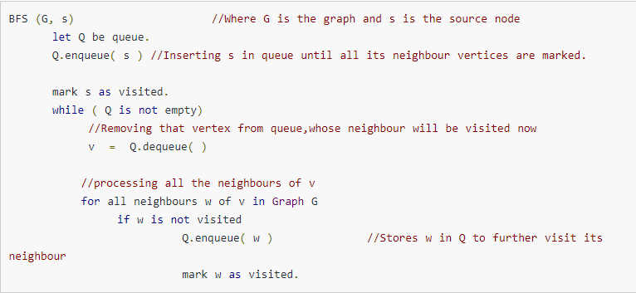
BFS pseudocode

Slide 26
BFS
COMPLETE? Complete only if b is finite.
OPTIMALITY NO/YES depends
Time complexity (1+ b^1+ b^2+ b^3+ ……b^d)=== O(b^d) quadratic time.
Space complexity (1+ b^1+ b^2+ b^3+ ……b^d)=== O(b^d) quadratic time.

Slide 27
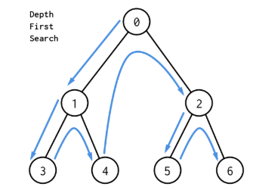
DFS
The DFS algorithm is a recursive algorithm that uses the idea of backtracking. It involves exhaustive searches of all the nodes by going ahead, if possible, else by backtracking.
This recursive nature of DFS can be implemented using stacks.

Slide 28
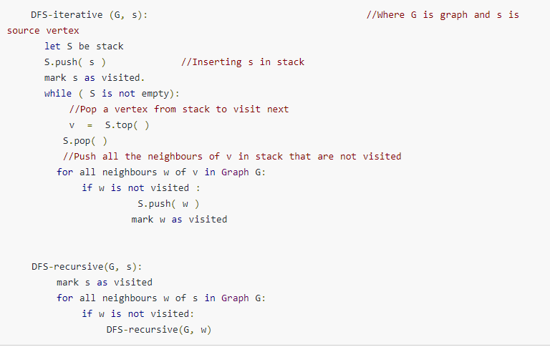
DFS pseudo code

Slide 29
DFS
Completeness? Yes only if M is finite
Optimality? NO
Time O(b^m) quadratic time.
Space complexity O(b *m)>>> Linear space.

Slide 30
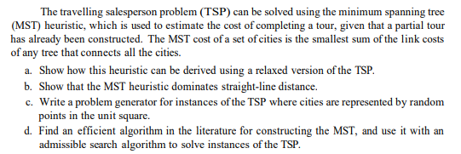
Assignment

Slide 31
REFERENCE MATERIALS
The design and Analysis of Computer Algorithms by AHO/Hocroft Ullman
Design and analysis of Algorithms by Russell L Shackelford
Introduction to the Design and Analysis of Algorithms by R.C.T Lee, S.S Tseng Chang Y.T Tsai
Judith L GerstingMathematical Structures for computer science 4th edition

